Slide 1
Data Analysis
Andrew Beatty
Andrew.beatty@gmit.ie
Programming for Cybersecurity

Slide 2
Not a complete Data analysis course
Packages that we use:
analysis
  Numpy
  Scipy
  Pandas
Visualisation
  Matplotlib
  Seaborn (used by pandas as well)
  Plotly (interactive)
AI
  Scirit-Learn
  Tensor flow
  PyTorch or Keras

Slide 3
Want to mention
R

Slide 4
Data analysis
Acquire the data
Clean the data
Analyse and explore the data
  Through numbers or visualisation
Tell the story

Slide 5
NUMPY
Used for analysing matrices (arrays of one or more dimensions)
Has it own data types
Powerful tools for going through the arrays quickly

Slide 6
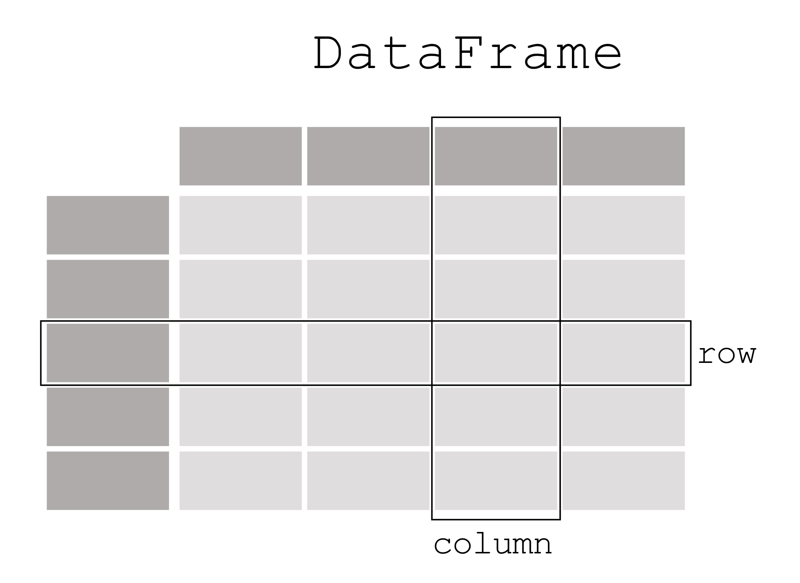

Pandas
See week 09 from last year
Column Name
index
index
Data

Slide 7
scipy
Extends numpy
Lots of statistical functions

Slide 8
Visualisation
Matplotlib
Seaborn
(I will try and get some example of these by Friday for you to loot at)

Slide 9
On to the stats

